Slide 1
Optimal Energy Sell-Back Agent
Title: Smart Energy Trading
Subtitle: Forecasting & Optimization for Smart Energy Trading
Presented by:
Abinash kar
VAMSHI
Vinay Kumar
Hazrathpasha
ALAVIKA
Sowmya

Slide 2
ABSTRACT
This project presents a smart energy trading system designed for solar panel users to maximize their profits. By using a time-series forecasting model (SARIMAX), the system predicts electricity prices based on historical data, demand, time, and seasonal patterns. It then identifies the optimal times to sell, store, or buy electricity. This approach improves decision-making, enhances energy efficiency, and supports sustainable energy usage.
Uses SARIMAX for price forecasting
Predicts sell-back and buyback prices
Optimizes energy trading decisions
Maximizes profit and efficiency
Supports sustainable energy systems

Slide 3
INTRODUCTION
Solar energy adoption is rapidly increasing due to environmental concerns and the shift toward renewable energy sources. Many users generate excess electricity that can be sold back to the grid. However, electricity prices fluctuate throughout the day depending on demand and supply. Without proper forecasting, users often sell energy at low prices. This project introduces a smart system that uses data analysis and forecasting to improve energy trading decisions.
Growth of renewable energy
Excess solar energy can be sold
Prices vary throughout the day
Lack of planning reduces profit
Smart system improves decisions

Slide 4
PROBLEM STATEMENT
Energy trading decisions are currently inefficient because users lack proper tools to predict electricity price changes. Most users sell electricity without considering peak pricing periods, resulting in financial loss. Additionally, there is no automated system to guide when to sell, store, or buy electricity. This leads to poor energy management and reduced profitability.
No accurate price prediction system
Selling happens at non-optimal times
No automation in decision-making
Leads to lower revenue
Inefficient energy usage

Slide 5
OBJECTIVE
The main objective of this project is to develop a forecasting and optimization system for energy trading. It aims to predict electricity prices accurately and identify the best times for selling and buying energy. The system also focuses on improving energy storage decisions to maximize overall efficiency and profit.
Forecast electricity prices
Identify best selling times
Optimize buying decisions
Improve battery usage
Increase overall profit

Slide 6
DATA OVERVIEW
The dataset used in this project includes historical electricity prices, timestamps, demand values, seasonal information, and day types. These features help in understanding how electricity prices vary over time. Two separate datasets are used for sell-back and buyback price prediction.
Includes time, demand, and price data
Seasonal and day-type information
Two datasets: sell-back & buyback
Helps analyze price patterns
Supports accurate forecasting

Slide 7
DATA PREPROCESSING
Before building the model, the data is cleaned and prepared for analysis. Timestamps are converted into useful features such as hour and day type. Categorical variables like season are encoded into numerical values. The data is then organized in a time-series format to ensure accurate forecasting.
Data cleaning and formatting
Extracted hour and day features
Encoded categorical variables
Organized time-series data
Selected important features

Slide 8
MODELING APPROACH
The project uses the SARIMAX model, which is a powerful time-series forecasting method. It captures trends, seasonality, and external factors like demand. This makes it suitable for predicting electricity prices, which change over time.
Uses SARIMAX model
Captures trends and seasonality
Uses external variables (demand, time)
Better than simple regression
Ideal for time-based data
Improves prediction accuracy

Slide 9
MODEL CONFIGURATION
The SARIMAX model is configured with specific parameters to capture both short-term and seasonal patterns. A 24-hour seasonal cycle is used to reflect daily price variations. External features such as demand and time are included to improve prediction accuracy.
Order: (1,1,1)
Seasonal Order: (1,1,1,24)
24-hour seasonal cycle
Uses demand and time features
Improves prediction accuracy

Slide 10
FORECASTING PROCESS
The model is trained using historical data and then used to predict future electricity prices. Future timestamps are generated, and corresponding features are created. The model outputs predicted prices for future time periods, which are used for decision-making.
Train model on past data
Generate future timestamps
Create future features
Predict future prices
Supports smart decisions

Slide 11
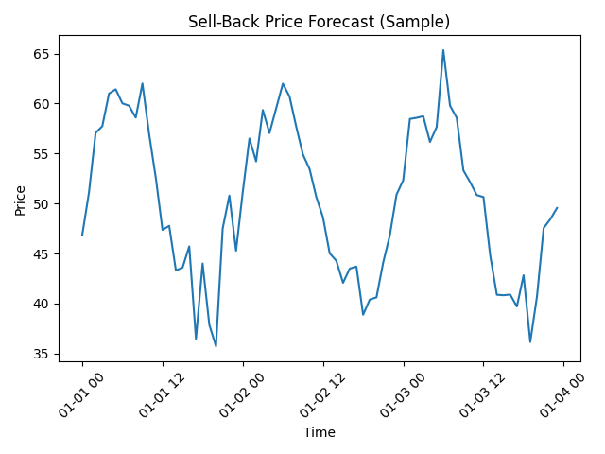
SELL-BACK-FORECAST
The sell-back price forecast shows how electricity prices change throughout the day. Prices are higher during peak demand hours and lower during off-peak times. This helps identify the best times to sell electricity for maximum profit.
Prices follow daily patterns
Higher during peak demand
Lower during off-peak hours
Helps identify best selling time
Improves revenue
Peak during high demand
Daily price pattern
Best time to sell identified

Slide 12
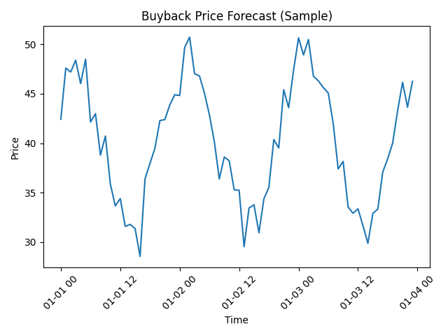
BUYBACK FORECAST
The buyback price forecast helps determine when electricity can be purchased at the lowest cost. Prices are typically lower during periods of low demand, making it beneficial to buy energy during those times.
Identifies low-price periods
Prices drop during low demand
Helps reduce energy cost
Supports better planning
Complements selling strategy
• Low during off-peak hours
• Helps reduce cost
• Supports better planning

Slide 13
OPTIMIZATION STRATERGY
Based on the forecasted prices, an optimization strategy is implemented. The system decides whether to sell, store, or buy electricity depending on price levels. This ensures maximum profit and efficient energy usage.
Sell at high prices
Store energy at medium prices
Buy at low prices
Acts like smart agent
Maximizes efficiency

Slide 14
RESULTS & OUTCOMES
The implementation of this system results in improved energy trading decisions. Users can achieve higher profits and better utilize their energy resources. The system also reduces energy waste and enhances overall efficiency.
Increased revenue (15–35%)
Better battery usage
Reduced energy waste
Improved efficiency
Smart decision-making

Slide 15
APPLICATIONS
This system can be applied in various real-world scenarios, including smart homes, microgrids, and energy trading platforms. It is useful for both individual users and large-scale energy providers.
Smart homes
Solar panel users
Microgrids
Energy trading platforms
Utility companies

Slide 16
FUTURE WORK
Future improvements can include integrating weather data for better solar predictions and using advanced machine learning models like LSTM. A real-time system with automated decision-making can also be developed.
Add weather data
Use AI/Deep learning models
Real-time forecasting
Automated trading system
Advanced optimization

Slide 17
CONCLUSION
This project demonstrates how forecasting and optimization can significantly improve energy trading decisions. By using SARIMAX, the system effectively predicts electricity prices and helps users maximize profit while promoting sustainable energy usage.
Forecasting improves decisions
SARIMAX is effective
Increases profit
Enhances efficiency
Supports sustainability

Slide 18
THANK YOU

